Slide 1
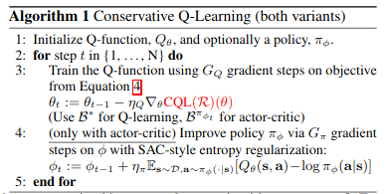
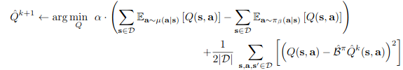
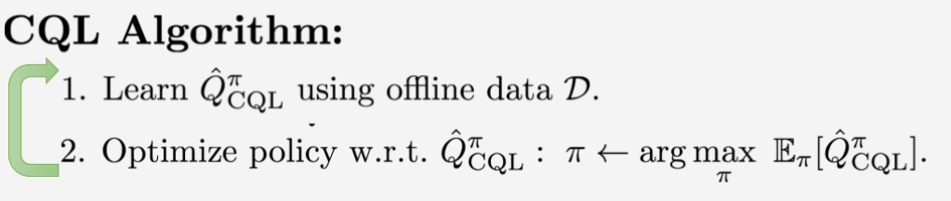
Mu defines whether it’s CQL(P) or CQL(H)

Slide 2
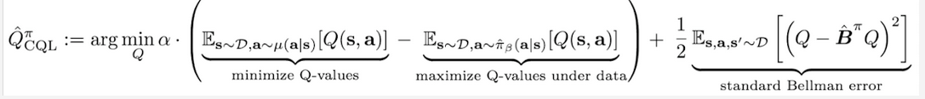


Both sampled data

Slide 3
See CQL(H)
???

Slide 4
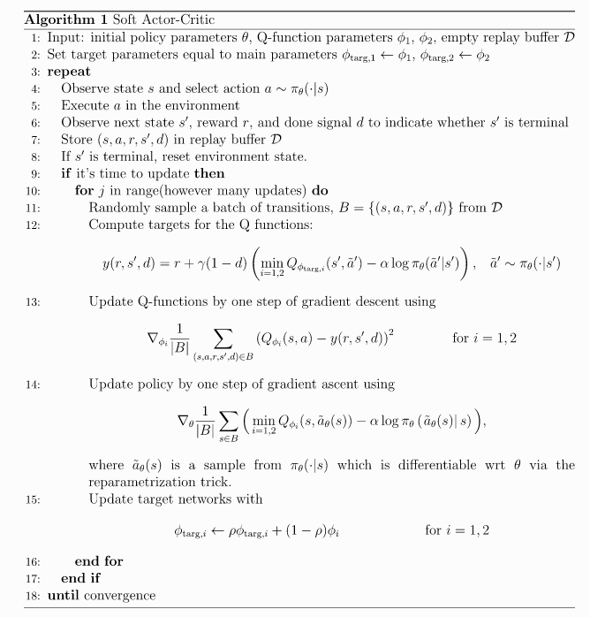

SAC

Slide 5

But in cont’s
Case? Think
This might be
Just a way
Of writing
It for proof
Not implm’n
Implm’n I found
Uses DDPG
Style loss
Just plug samples
in

